Slide 1
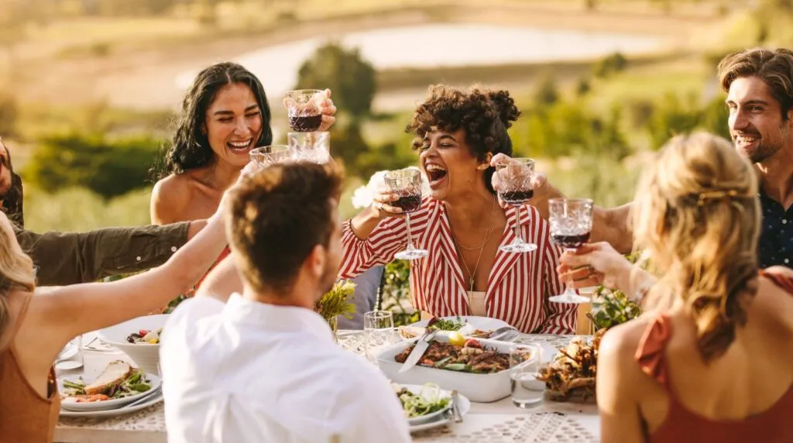
TELLING THE POSITIVE STORY ABOUT WINE…
www.cometogetherforwine.com

Slide 2
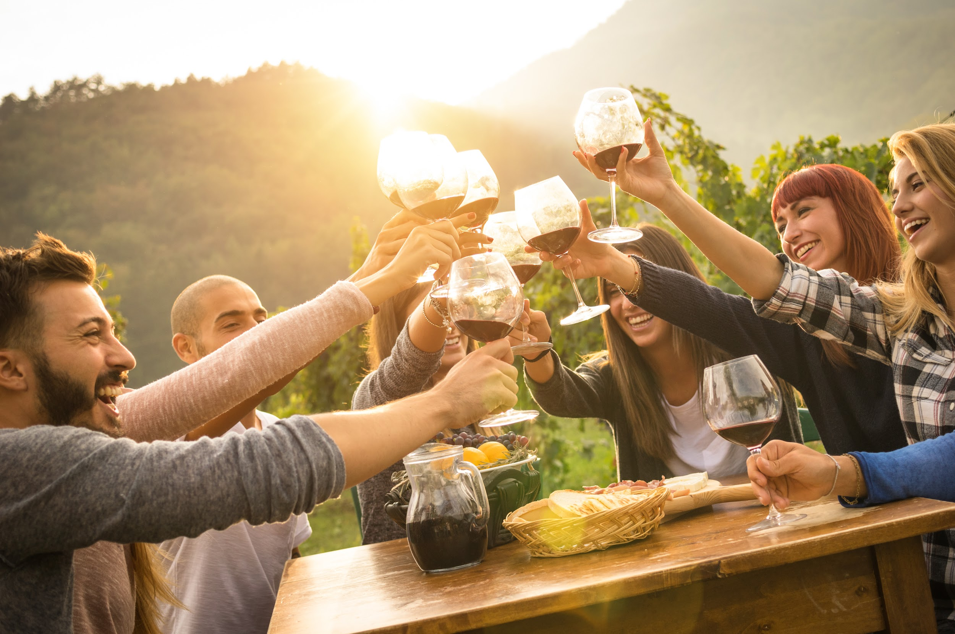
COME TOGETHER– A COMMUNITY FOR WINE:
WHAT IS IT?
COME TOGETHER– A Community for Wine Inc. is a mission driven company committed to communicating positive messages about moderate wine consumption.
Through campaigns like Come Over October and Share & Pair Sundays, we hope to keep wine’s beneficial role in culture and lifestyle alive– and to help it thrive.
Confidential Document. Copyright: COME TOGETHER—A Community for Wine LLC

Slide 3
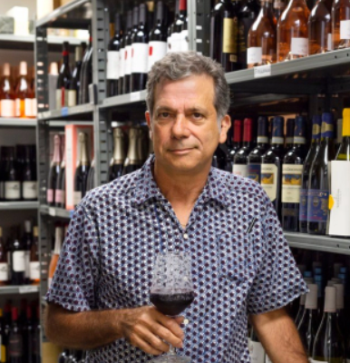
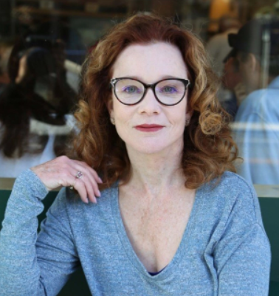
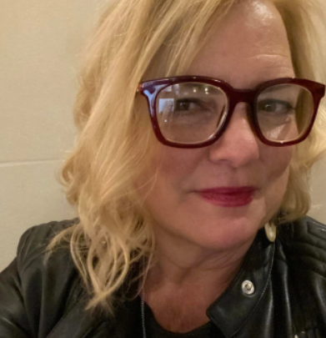
WHO IS BEHIND IT?
WHAT IS IT?
The idea for Come Together For Wine was conceived in Spring 2024 by Karen MacNeil, author of The Wine Bible. MacNeil shared the idea with two friends-- Kimberly Charles and Gino Colangelo-- who are marketing and public relations specialists. Together, the three formed the mission-driven company, COME TOGETHER-- A Community for Wine, whose first campaign was Come Over October 2024.
Gino Colangelo
President,
Colangelo & Partners
Karen MacNeil
Speaker, Consultant, Author of The Wine Bible
Kimberly Charles, DipWSET
President & Founder,
Charles Communications
Associates
Confidential Document. Copyright: COME TOGETHER—A Community for Wine LLC

Slide 4
WILL COME OVER OCTOBER CONTINUE?
Yes!
Based on the resounding success of Come Over October 2024, we will launch COO 2025 in late summer to make its impact even larger. We believe COO and Share & Pair Sundays complement each other as campaigns and now give us “yearly coverage.”
Confidential Document. Copyright: COME TOGETHER—A Community for Wine LLC

Slide 5
SUPPORT US! BECOMING A FOUNDATIONAL PARTNER
www.cometogetherforwine.com

Slide 6
BECOMING A FOUNDATIONAL PARTNER*: THE OFFER
Board level leadership role in the direction of campaign strategies and activities
Acknowledgement at events, press conferences and industry presentations, wines poured at events
Product placement with chefs and food influencers / bloggers for the ‘Share & Pair Sundays’ campaign
Logo inclusion in advertisements (e.g. Wine Spectator, Wine Enthusiast, Vinepair, SOMM Journal)
Presentation on new campaigns to Foundational Partner’s executive team
Logo inclusion on campaign and company websites in special ‘Foundational Partner’ section
(www.comeoveroctober.com)
(www.share&pairsundays.com)
(www.cometogetherforwine.com)
Tags on social media posts (IG, Facebook) (16x/year)
IG Live with Karen MacNeil including pre promotion of IG live(3x/year)
Brainstorming session with KC, KM, and/or GC on how your wine brand can maximize their involvement in the campaign
Inclusion in press releases and press interviews and invitation to all press conferences
1 appearance by Karen MacNeil at a Benefactor event in 2025, schedule permitting (travel expenses not included)
Promotion and links to your sponsored events on our website, ensuring increased visibility and driving foot traffic and attendance to any winery or brand-hosted activities
Confidential Document. Copyright: COME TOGETHER—A Community for Wine LLC

Slide 7
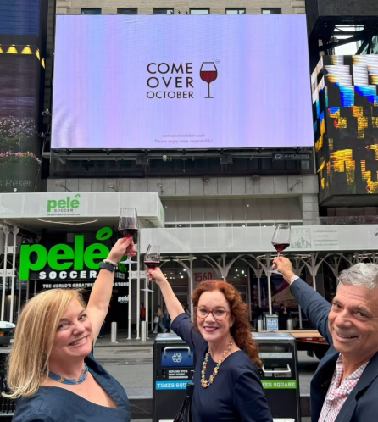
BECOMING A FOUNDATIONAL PARTNER: THE ASK
$25,000/year with a 2-year commitment
Participation at quarterly partner meetings
Amplification of the Share & Pair Sundays and Come Over October campaigns
Your help in reaching other companies and individuals who can help us tell and expand the positive story about wine
Confidential Document. Copyright: COME TOGETHER—A Community for Wine LLC

Slide 8
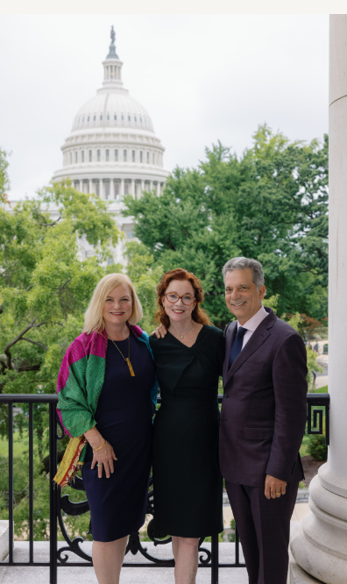
BECOMING A FOUNDATIONAL PARTNER: WHY DO IT?
Wine drinking is at a critical juncture. The time to turn the tide and change narrative to a positive one, is now
Board-level leadership role in the direction of campaign strategies and activities
Key inclusion in press pitches and press releases about the campaigns; product placement
Access to Karen MacNeil for agreed upon social media content
Access to Patrons and Friends who can positively impact your business (i.e. retailers, distributors, restaurants)
Confidential Document. Copyright: COME TOGETHER—A Community for Wine LLC

Slide 9
HELP US ADVOCATE FOR WINE!
CONTRIBUTION LEVELS
BENEFACTOR: $10,000
SPONSOR: $5,000
CHAMPION: $2,500
CONTRIBUTOR: $1,000
Confidential Document. Copyright: COME TOGETHER—A Community for Wine LLC

Slide 10
CONTRIBUTOR: $1,000
CONTRIBUTOR RECEIVES:
Logo inclusion on campaign and company websites
(www.comeoveroctober.com)
(www.share&pairsundays.com)
(www.cometogetherforwine.com)
Tags on social media posts (IG, Facebook) (4x/year)
Invitation to all press conferences
Access to collaborative opportunities, leveraging our extensive network of industry contacts to amplify your brand visibility in print, digital media, and joint campaigns
Promotion and links to your sponsored events on our website and instagram, ensuring increased visibility and driving foot traffic and attendance to any winery or brand-hosted activities
Confidential Document. Copyright: COME TOGETHER—A Community for Wine LLC

Slide 11
CHAMPION: $2,500
CHAMPION RECEIVES:
Logo inclusion on campaign and company websites
(www.comeoveroctober.com)
(www.share&pairsundays.com)
(www.cometogetherforwine.com)
Tags on social media posts (IG, Facebook) (6x/year)
IG Live with Karen MacNeil, including pre-promotion on our social platforms (1x/year)
Brainstorming session with KC, KM, and/or GC on how your wine brand can maximize their involvement in the campaign (1x/year)
Invitation to all press conferences
Access to collaborative opportunities, leveraging our extensive network of industry contacts to amplify your brand visibility in print, digital media, and joint campaigns
Promotion and links to your sponsored events on our website and instagram, ensuring increased visibility and driving foot traffic and attendance to any winery or brand-hosted activities
Confidential Document. Copyright: COME TOGETHER—A Community for Wine LLC

Slide 12
SPONSOR: $5,000
SPONSOR RECEIVES:
Logo inclusion on campaign and company websites
(www.comeoveroctober.com)
(www.share&pairsundays.com)
(www.cometogetherforwine.com)
Tags on social media posts (IG, Facebook) (8x/year)
IG Live with Karen MacNeil, including pre-promotion on our social platforms (2x/year)
Brainstorming session with KC, KM, and/or GC on how your wine brand can maximize their involvement in the campaign (2x/year: 1x Come Over October, 1x Share and Pair Sundays)
Invitation to all press conferences
Product placement opportunities with chefs, food influencers and bloggers participating in the campaign
Access to collaborative opportunities, leveraging our extensive network of industry contacts to amplify your brand visibility in print, digital media, and joint campaigns
Promotion and links to your sponsored events on our website and instagram, ensuring increased visibility and driving foot traffic and attendance to any winery or brand-hosted activities
Confidential Document. Copyright: COME TOGETHER—A Community for Wine LLC

Slide 13
BENEFACTOR: $10,000
BENEFACTOR RECEIVES:
Logo inclusion on campaign and company websites
(www.comeoveroctober.com)
(www.share&pairsundays.com)
(www.cometogetherforwine.com)
Tags on social media posts (IG, Facebook) (12x/year)
IG Live with Karen MacNeil, including pre promotion of the IG live (3x/year)
Brainstorming session with KC, KM, and/or GC on how your wine brand can maximize their involvement in the campaign (2x/year: 1x Come Over October, 1x Share and Pair Sundays)
Inclusion in press releases and press interviews and invitation to all press conferences
Product placement opportunities with chefs, food influencers and bloggers participating in the campaign
1 appearance by Karen MacNeil at a Benefactor event in 2025, schedule permitting (travel expenses not included)
Access to collaborative opportunities, leveraging our extensive network of industry contacts to amplify your brand visibility in print, digital media, and joint campaigns
Promotion and links to your sponsored events on our website and instagram, ensuring increased visibility and driving foot traffic and attendance to any winery or brand-hosted activities
Confidential Document. Copyright: COME TOGETHER—A Community for Wine LLC

