Slide 1
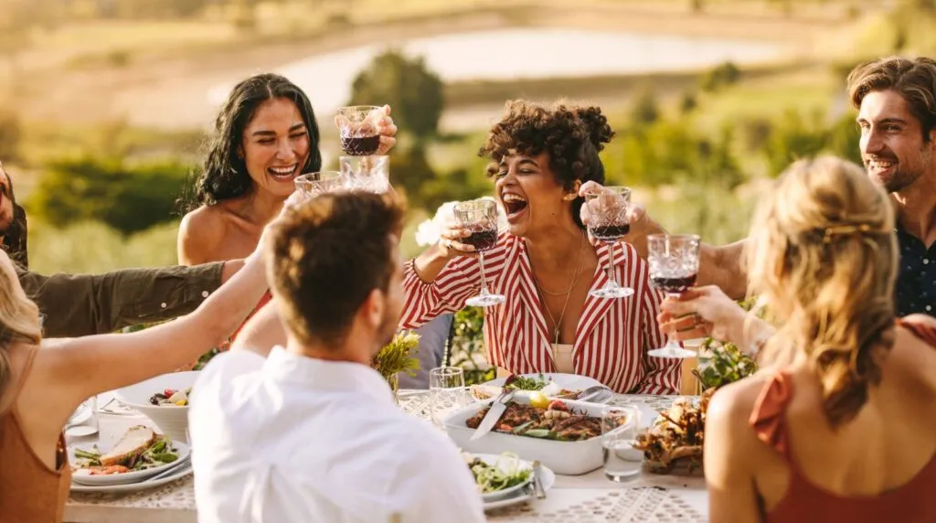
TELLING THE POSITIVE STORY ABOUT WINE…
www.cometogetherforwine.com

Slide 2
COME TOGETHER– A COMMUNITY FOR WINE:
WHAT IS IT?
COME TOGETHER– A Community for Wine Inc. is a mission driven company committed to communicating positive messages about moderate wine consumption.
Through campaigns like Come Over October and Share & Pair Sundays, we hope to keep wine’s beneficial role in culture and lifestyle alive– and to help it thrive.
Confidential Document. Copyright: COME TOGETHER—A Community for Wine LLC

Slide 3
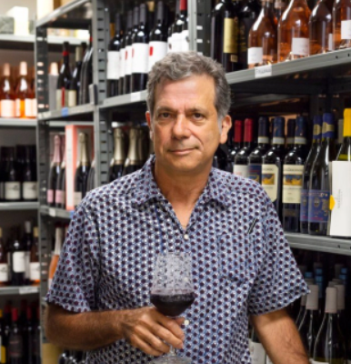
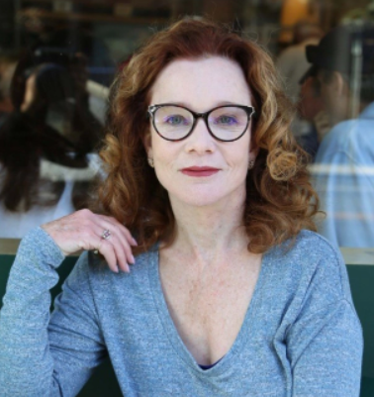
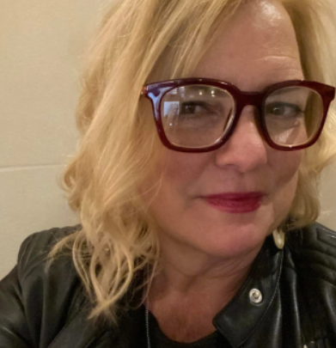
WHO IS BEHIND IT?
WHAT IS IT?
The idea for Come Together For Wine was conceived in Spring 2024 by Karen MacNeil, author of The Wine Bible. MacNeil shared the idea with two friends-- Kimberly Charles and Gino Colangelo-- who are marketing and public relations specialists. Together, the three formed the mission-driven company, COME TOGETHER-- A Community for Wine, whose first campaign was Come Over October 2024.
Gino Colangelo
President,
Colangelo & Partners
Karen MacNeil
Speaker, Consultant, Author of The Wine Bible
Kimberly Charles, DipWSET
President & Founder,
Charles Communications
Associates
Confidential Document. Copyright: COME TOGETHER—A Community for Wine LLC

Slide 4
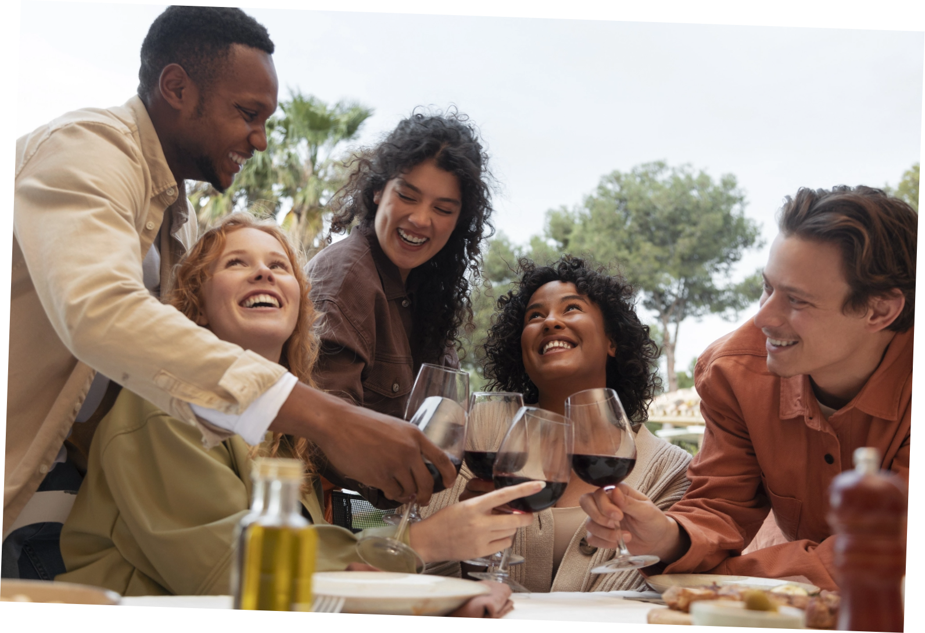
CAMPAIGN REACH
CELEBRATING A SUCCESSFUL INAUGURAL CAMPAIGN, LOOKING FORWARD TO 2025
@comeoveroctober
www.comeoveroctober.com
Confidential Document. Copyright: COME TOGETHER—A Community for Wine LLC

Slide 5
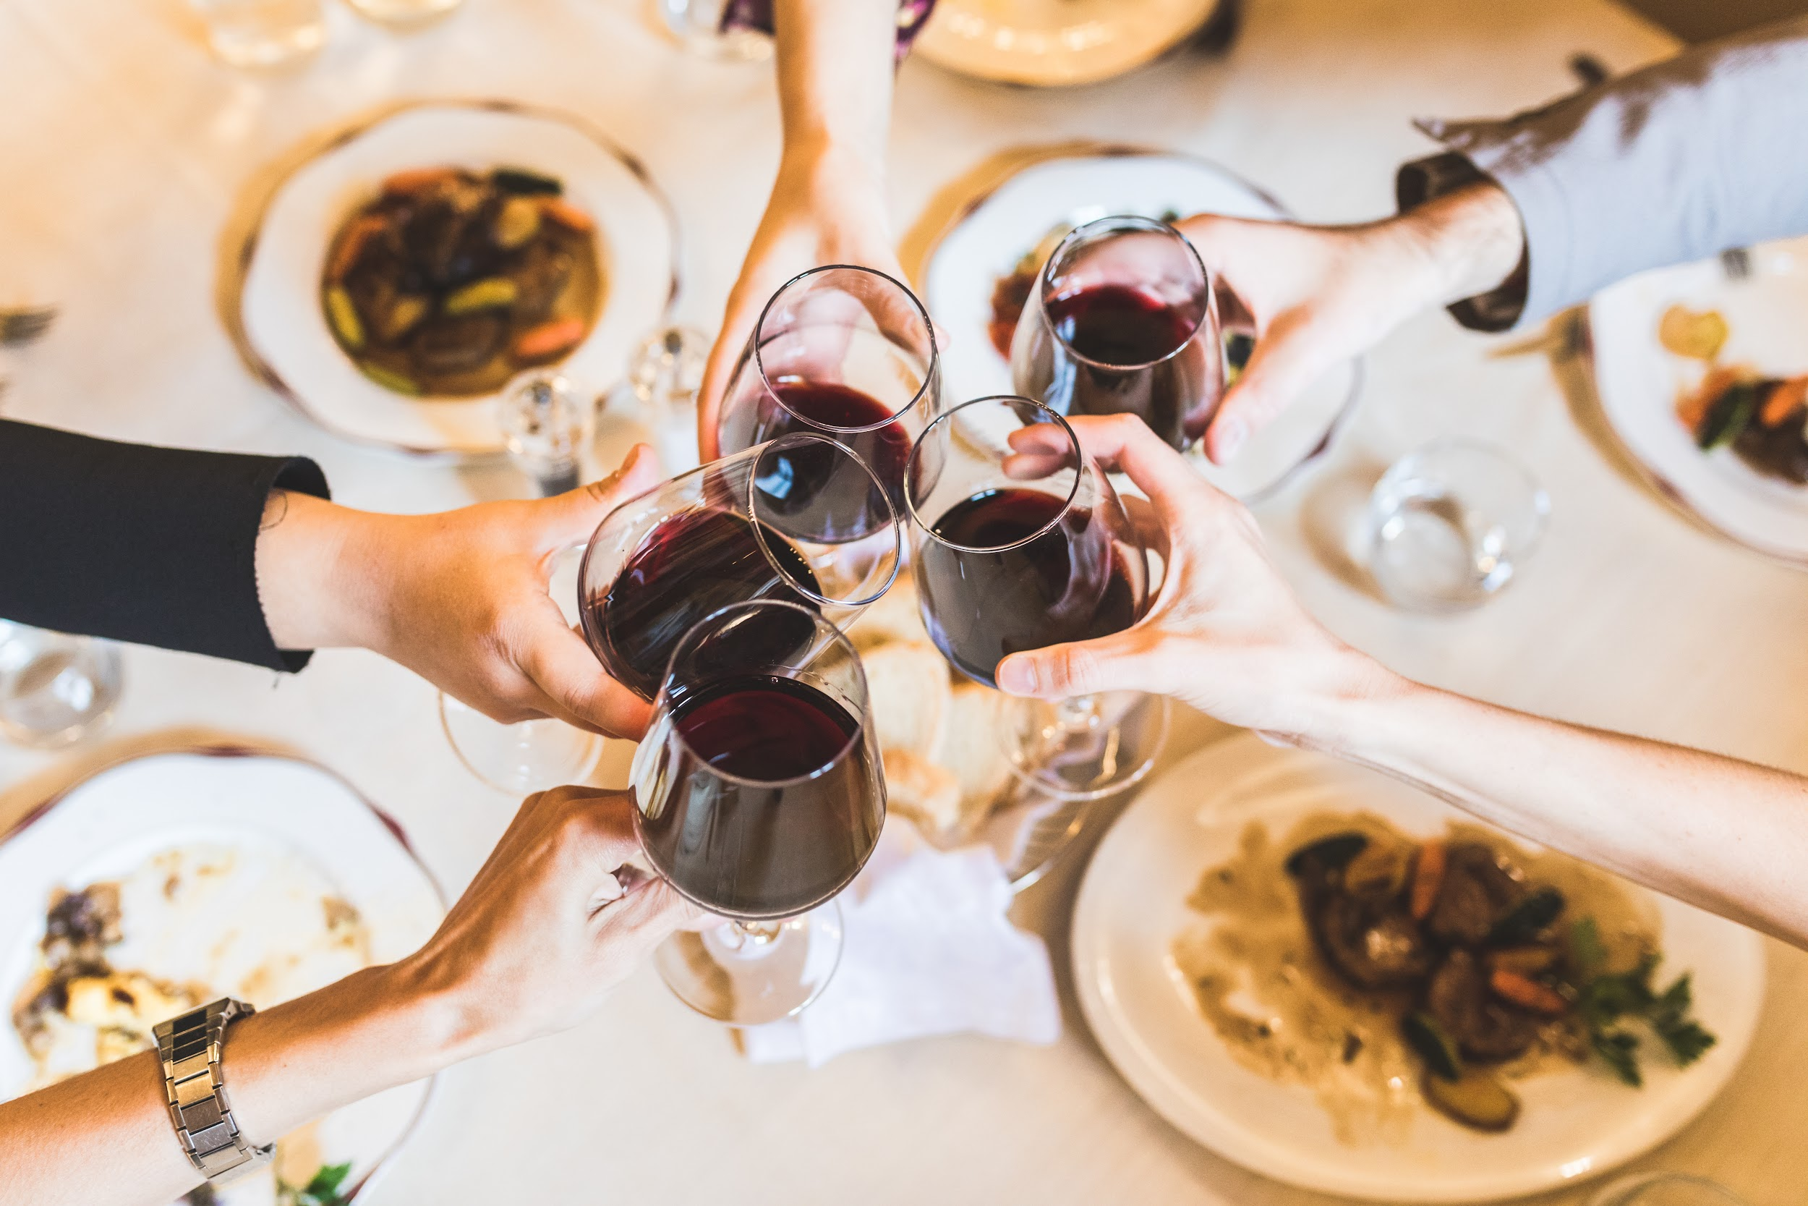
COME OVER OCTOBER: WHAT IS IT?
WHAT IS IT?
Come Over October is an international campaign during the month of October encouraging wine drinkers to invite friends, colleagues, neighbors, and family to “come over” to a home, a restaurant, or wherever people gather, to share wine and friendship.
Come Over October honors wine’s 8,000 year history as a communal beverage that brings people together. As an agricultural product consumed with the company of others and most often with food, wine plays a positive role in society and culture.
Confidential Document. Copyright: COME TOGETHER—A Community for Wine LLC

Slide 6
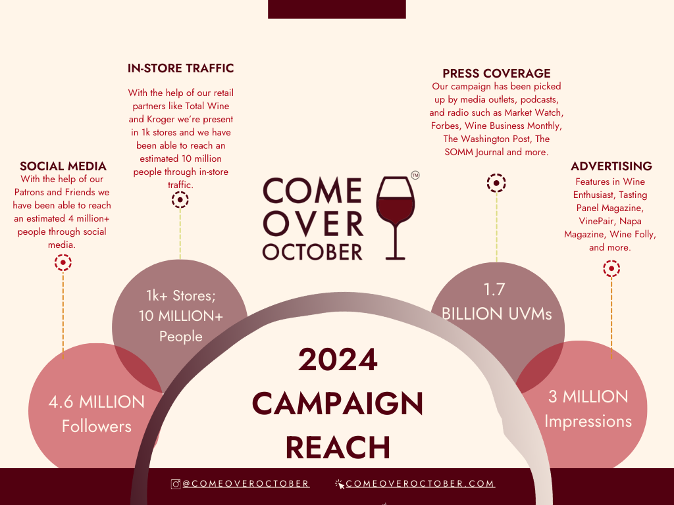
Confidential Document. Copyright: COME TOGETHER—A Community for Wine LLC
CAMPAIGN REACH
Official Rideshare Partner

Slide 7
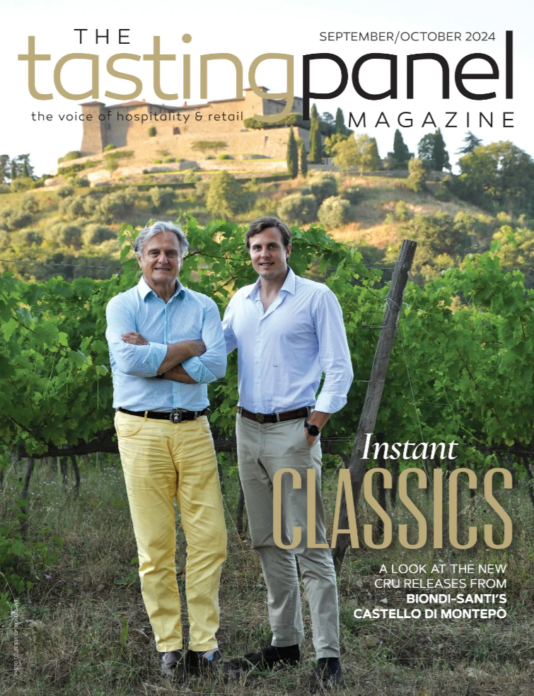
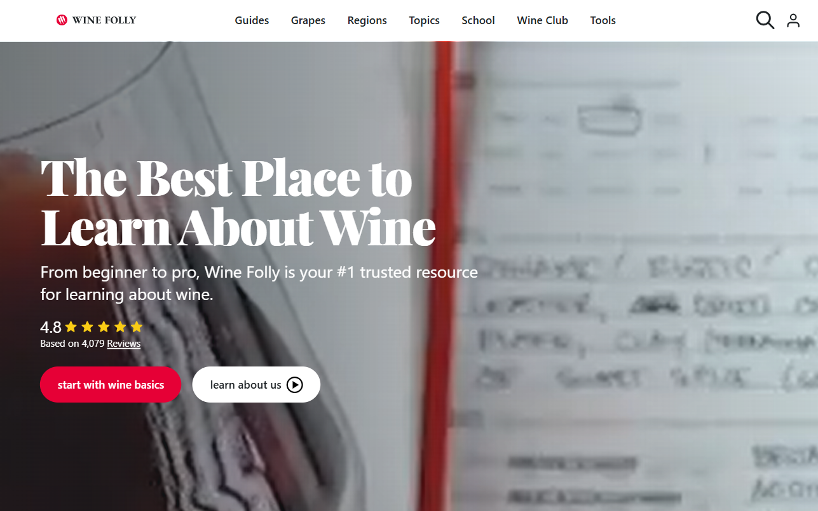
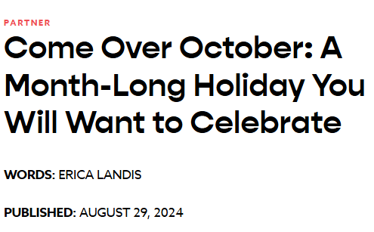
ADVERTISING
Advertising
Confidential Document. Copyright: COME TOGETHER—A Community for Wine LLC

Slide 8
PRESS HIGHLIGHTS
Advertising
Confidential Document. Copyright: COME TOGETHER—A Community for Wine LLC

Slide 9
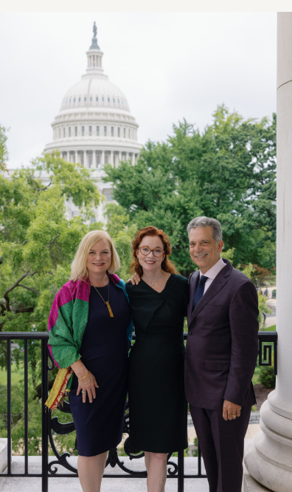
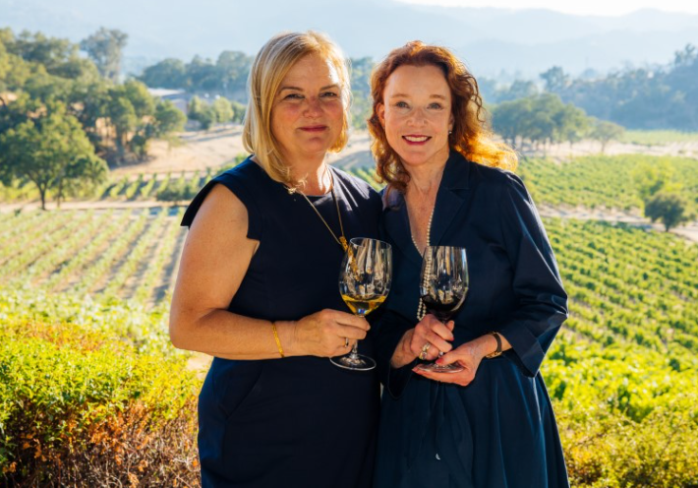
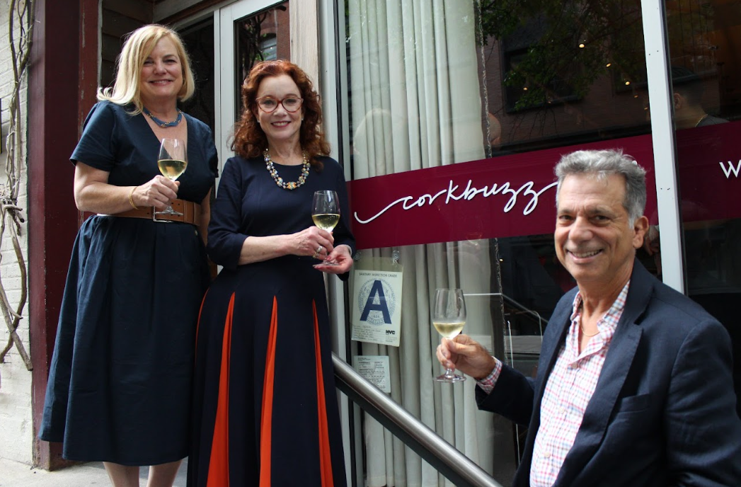
NATIONAL PRESS EVENTS
National Press Events
With the invaluable support of our Patrons and Friends, we were able to successfully launch Come Over October with four press conferences—one each in Napa Valley, New York City and Washington D.C, as well as a virtual press conference.
Napa Valley, California
New York City
Washington D.C.
Confidential Document. Copyright: COME TOGETHER—A Community for Wine LLC

Slide 10
WHAT’S NEXT?

Slide 11
CAMPAIGN REACH
‘SHARE & PAIR SUNDAYS’ COMING SPRING 2025
@shareandpairsundays
www.shareandpairsundays.com
Confidential Document. Copyright: COME TOGETHER—A Community for Wine LLC

Slide 12
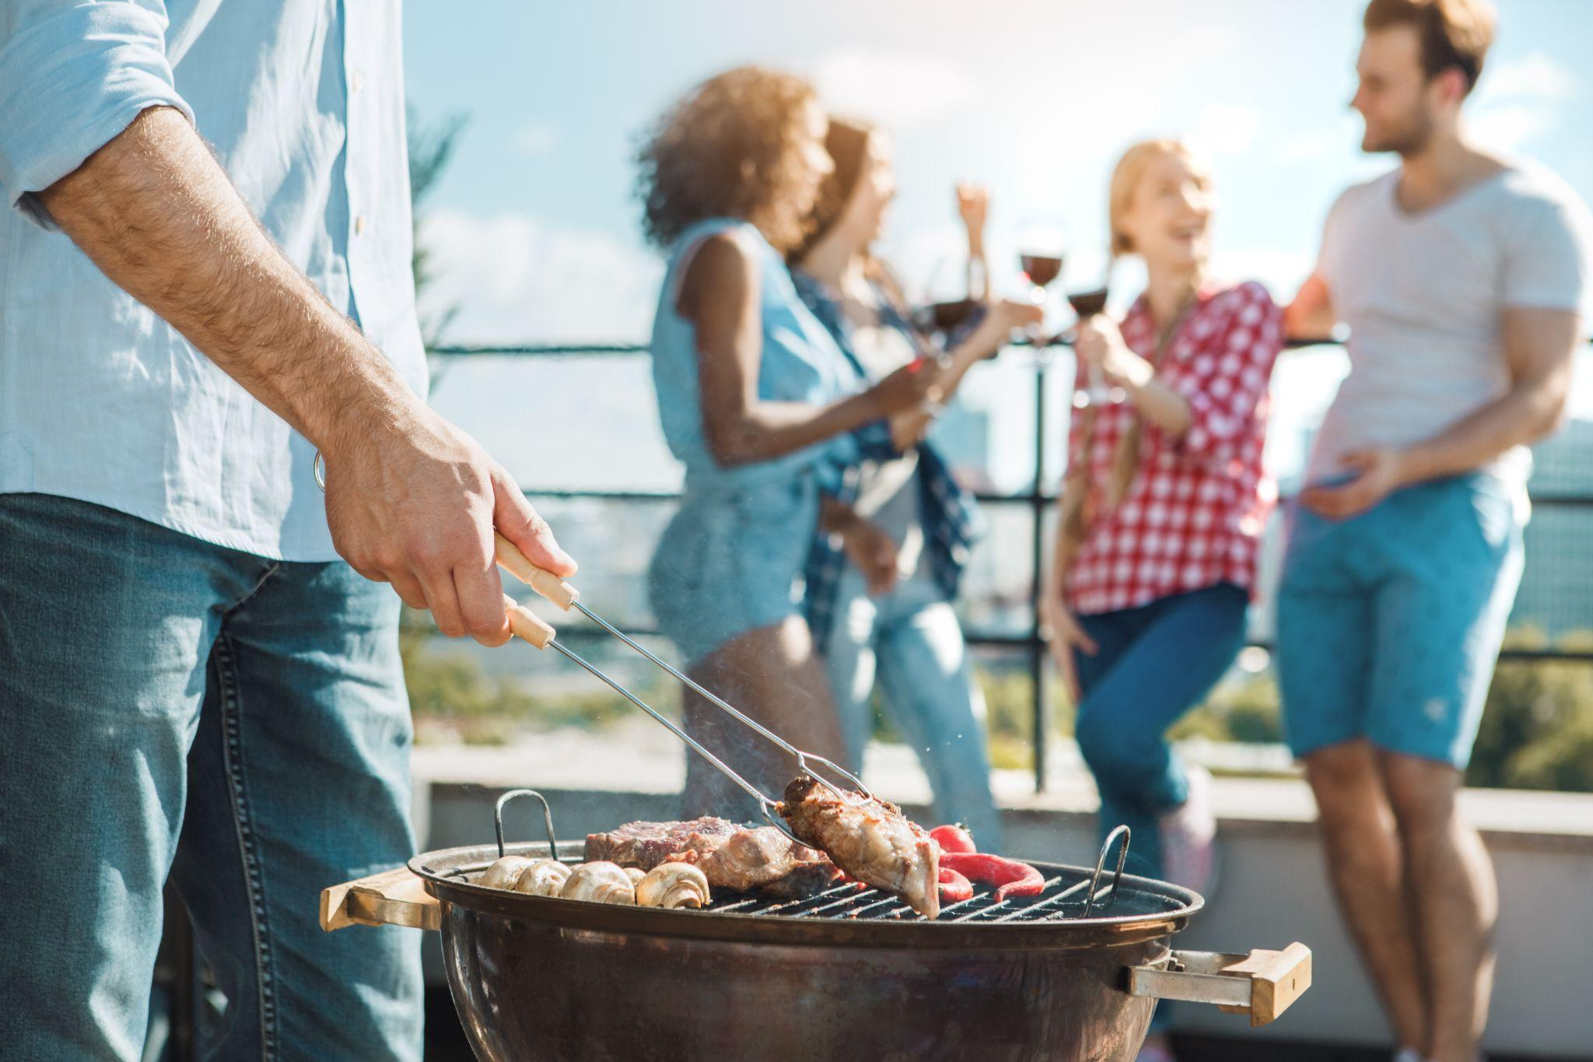
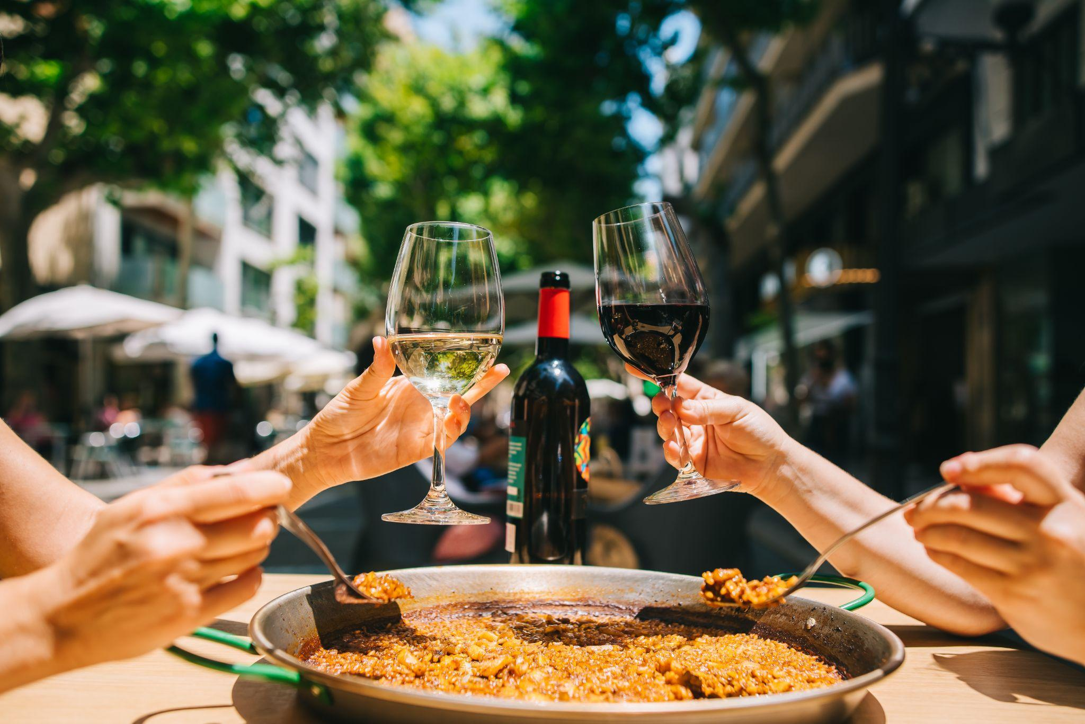
SHARE & PAIR SUNDAYS: WHAT IS IT?
Share & Pair Sundays is a 2025 Spring-to-Summer campaign that celebrates the delicious marriage of wine and food. The campaign encourages consumers to get together on Sundays to enjoy wine, food and friends. Share & Pair Sundays begins March 23rd through June 1st.
Share & Pair Sundays was created by the team behind the successful Come Over October 2024 campaign—journalist and content creator Karen MacNeil, and communications and marketing specialists Kimberly Noelle Charles and Gino Colangelo.
This campaign targets people who love wine and people who love food– of all ages, races, and cultures.
Confidential Document. Copyright: COME TOGETHER—A Community for Wine LLC

Slide 13
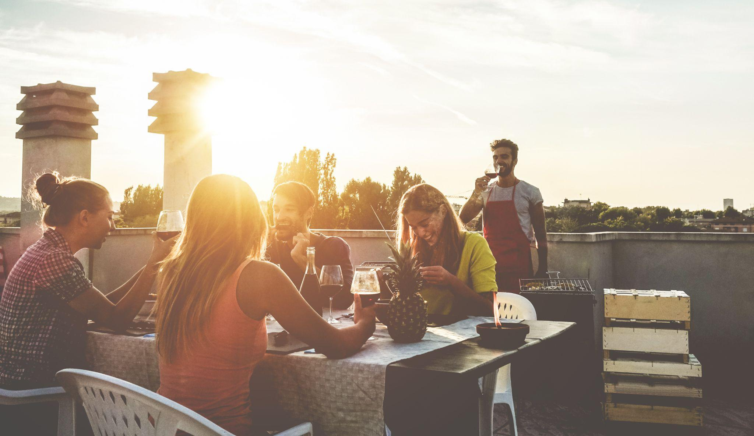
WHAT TO LOOK FORWARD TO?
Activations:
Much like Come Over October, different segments of the wine and food industries will execute different creative promotions. These may include in-store promotions of wine and food pairings, special wine dinner promotions in restaurants and hotels, food-and-wine tastings by wineries, food pairing ideas in DTC wine shipments and so on.
The Share & Pair Sundays team is especially keen to broaden wine’s appeal by its association with different cultural foodways. We envision creative activations with the Hispanic, Asian, and Black communities by encouraging members of those communities to share traditional dishes and foods with various wines.
Media and Social Media Campaigns:
The Share & Pair Sundays team has strong connections with wine, food, and lifestyle media in print, digital, radio, and television.
The Share & Pair team also plans to execute a strong Social campaign aimed not only at wine personalities but also celebrities, sports figures, celebrity chefs, and food professionals and food influencers. Karen MacNeil will once again host a vigorous Instagram Live campaign.
Additionally, the Share & Pair Sundays team will provide a new easy pairing each week (from a renowned chef and a wine professional) for consumers to enjoy, encouraging consumers to make every Sunday a Share & Pair Sunday.
Confidential Document. Copyright: COME TOGETHER—A Community for Wine LLC

Slide 14
WILL COME OVER OCTOBER CONTINUE?
Yes!
Based on the resounding success of Come Over October 2024, we will launch COO 2025 in late summer to make its impact even larger. We believe COO and Share & Pair Sundays complement each other as campaigns and now give us “yearly coverage.”
Confidential Document. Copyright: COME TOGETHER—A Community for Wine LLC

Slide 15
SUPPORT US! BECOMING A FOUNDATIONAL PARTNER
www.cometogetherforwine.com

Slide 16
BECOMING A FOUNDATIONAL PARTNER*: THE OFFER
Board level leadership role in the direction of campaign strategies and activities
Acknowledgement at events, press conferences and industry presentations, wines poured at events
Product placement with chefs and food influencers / bloggers for the ‘Share & Pair Sundays’ campaign
Logo inclusion in advertisements (e.g. Wine Spectator, Wine Enthusiast, Vinepair, SOMM Journal)
Presentation on new campaigns to Foundational Partner’s executive team
Logo inclusion on campaign and company websites in special ‘Foundational Partner’ section
(www.comeoveroctober.com)
(www.share&pairsundays.com)
(www.cometogetherforwine.com)
Tags on social media posts (IG, Facebook) (16x/year)
IG Live with Karen MacNeil including pre promotion of IG live(3x/year)
Brainstorming session with KC, KM, and/or GC on how your wine brand can maximize their involvement in the campaign
Inclusion in press releases and press interviews and invitation to all press conferences
1 appearance by Karen MacNeil at a Benefactor event in 2025, schedule permitting (travel expenses not included)
Promotion and links to your sponsored events on our website, ensuring increased visibility and driving foot traffic and attendance to any winery or brand-hosted activities
Confidential Document. Copyright: COME TOGETHER—A Community for Wine LLC

Slide 17
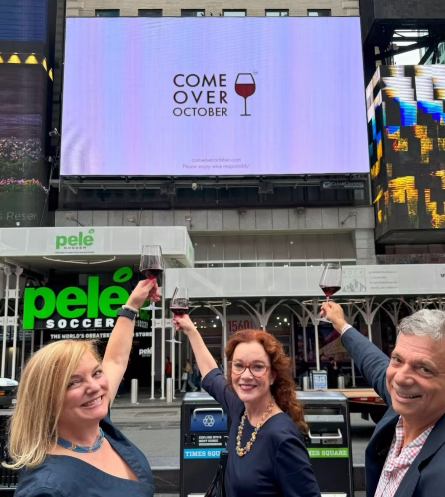
BECOMING A FOUNDATIONAL PARTNER: THE ASK
$25,000/year with a 2-year commitment
Participation at quarterly partner meetings
Amplification of the Share & Pair Sundays and Come Over October campaigns
Your help in reaching other companies and individuals who can help us tell and expand the positive story about wine
Confidential Document. Copyright: COME TOGETHER—A Community for Wine LLC

Slide 18
BECOMING A FOUNDATIONAL PARTNER: WHY DO IT?
Wine drinking is at a critical juncture. The time to turn the tide and change narrative to a positive one, is now
Board-level leadership role in the direction of campaign strategies and activities
Key inclusion in press pitches and press releases about the campaigns; product placement
Access to Karen MacNeil for agreed upon social media content
Access to Patrons and Friends who can positively impact your business (i.e. retailers, distributors, restaurants)
Confidential Document. Copyright: COME TOGETHER—A Community for Wine LLC

